Slide 1
Debugging Your Code in Eclipse

Slide 2
Debugging
Debugging is the process of identifying and fixing any issues in the source code of a program.
Modern IDEs like Eclipse provide debugging tools that make it easier for developers to walk through their code interactively and inspect it to spot and resolve any issues.

Slide 3
Example Program:
public class Debugging {
public int reverse(int number){
int rev = 0;
while(number != 0) {
int remainder = number % 10;
rev = rev * 10 + remainder;
number = number/10;
}
return rev;
}
public static void main(String[] args)
{
Debugging debug=new Debugging();
int input=6968;
int number=debug.reverse(input);
System.out.println("The reverse of the given number is: " +number);
}
}

Slide 4
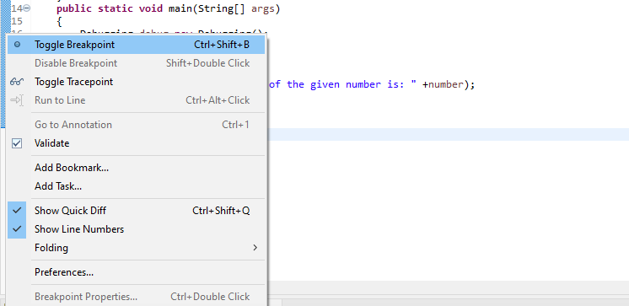
Step 1 : Set Breakpoints
A breakpoint is a point in code where the program execution pauses during debugging.
This allows the programmer to inspect code and the flow of execution at the defined breakpoint.
To define a breakpoint, either double click on the left margin in the editor or right click and select Toggle Breakpoint.

Slide 5
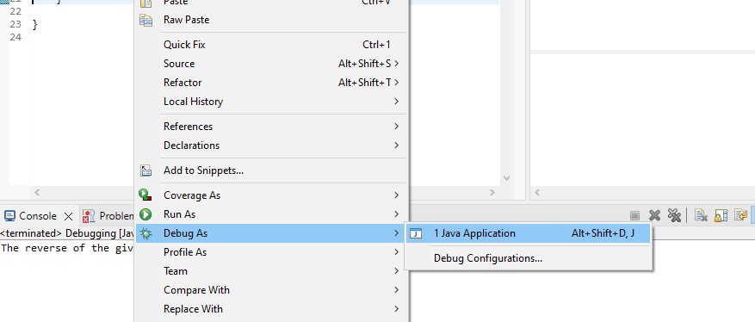
Step 2 : Start the Program in Debug Mode
To debug the application, either right-click on the file in Package Explorer or within the Java editor and select Debug As -> Java Application:

Slide 6
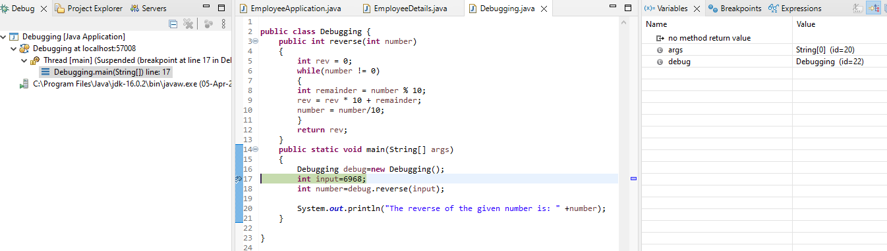
If you click Switch, Eclipse opens this perspective, which has a group of views that help with the debugging process:

Slide 7
The most commonly used views are described below:
Debug: Displays the call stack which helps in determining the flow of execution of the program until the breakpoint is reached
Variables: Displays fields and defined variables in the current stack
Breakpoints: Shows a list of all breakpoints in the code and enabling/disabling breakpoints
Expressions: Allows defining custom Java expressions to inspect their values
Eclipse also provides several buttons in the toolbar for controlling the flow of execution of the program:

Slide 8
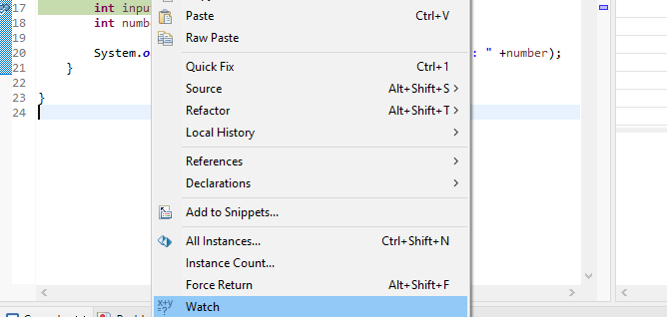
Step 3 : Add Variables to Expressions for Examination
Any custom Java expressions (including variables) and their values
can be inspected in the Expressions view.
For example, to track the value of the number and the rev variables,
they can be added to the Expressions view by right-clicking on each and
then clicking Watch:

Slide 9
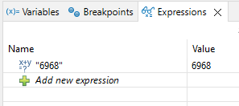
Step 4 : Check the Variables Values in Expressions
The variables are now visible in the Expressions view:

Slide 10
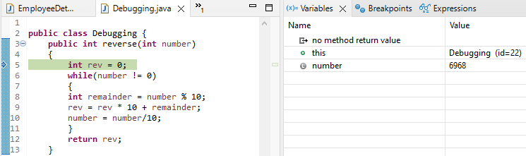
Step 5 : Step Into the Function
Press F5 or the Step Into icon to enter into the reverse method:

Slide 11
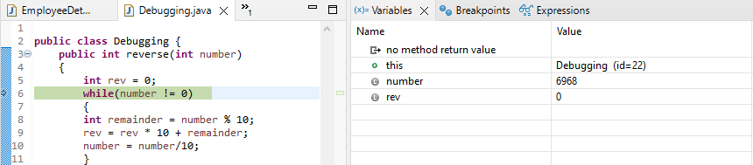
Step 6 : Step Over
Press F6 or the Step Over icon to execute the current line of code and go to the next one:

Slide 12
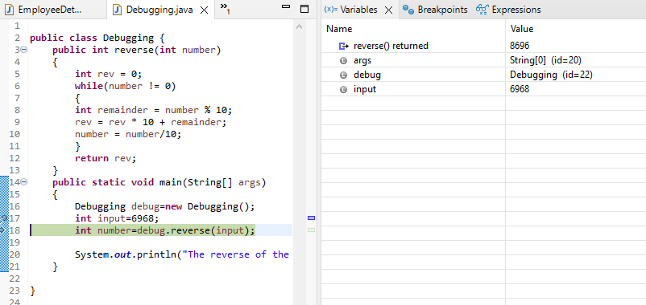
Step 7 : Check the Return Value from Function
Press Step Over again to return to the main() method:

Slide 13
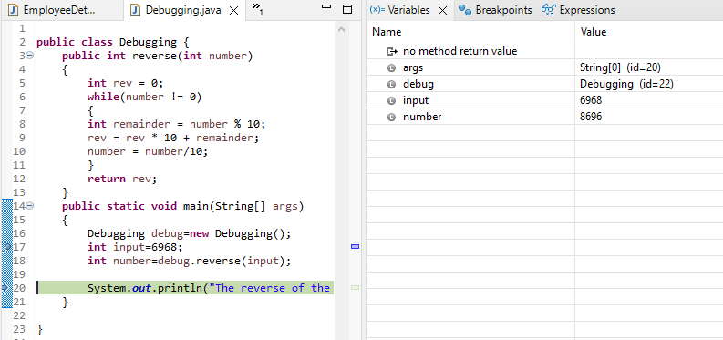
The debugger returns to stop on the same line where it left previously in Step 5.
Press Step Over again to check the return value from the reverse() method:

Slide 14
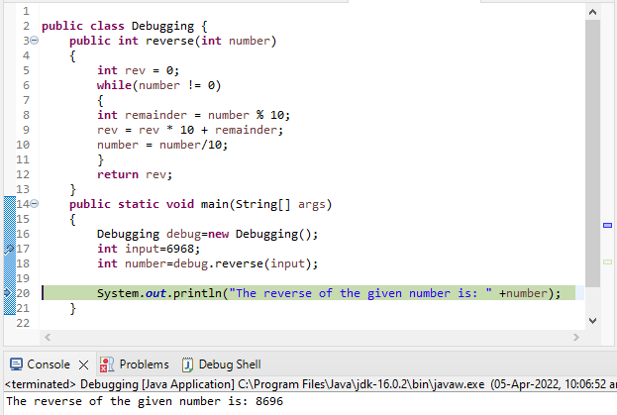
Step 8 : Print The Result
At this point, line 20 executes and prints the result to the Console successfully:

Slide 15
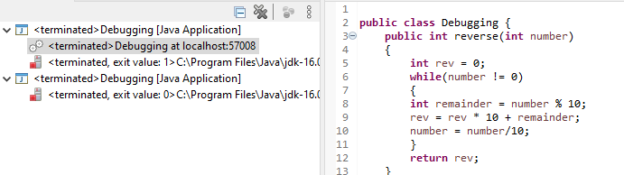
Step 9 : Stop in Main
The debugger can now be stopped by pressing the Terminate icon in the toolbar.
The debugger will now be disconnected:

